Slide 1
INDIAN INSTITUE OF INFORMATION TECHNOLOGY, DHARWAD.

Slide 2
Topic : Music information retrieval system using opensource tools (MIRs).

Slide 3
overview
The main objective of this project is, it helps the user to identify the name of the music/song or album just by listening to a small portion of the music.
Thing used in this project
Python2.7 – is the programming language used in the project.
Additional dependencies
Python2-pip – is a python package manager used to add or remove python packages

Slide 4
Things used in this project
Python2.7 – is the programming language used in this project.
Python-pip – python package manager used to add or remove packages.
Python-tk – python library used to create GUI ( graphical user interface ).
ffmpeg – it is a command line tool designed to process audio and video files.
Portaudio – is a library used for audio playbacks and recording.
Pyaudio - provides Python bindings for PortAudio, With PyAudio, you can easily use Python to play and record audio on a variety of platforms.

Slide 5
Things used in this project
Matplotlib – is a python library used to data visualization and graphical plotting library for Python and its numerical extension NumPy.
Termcolor – it is a python module used for Color formatting for output in the terminal.
Scipy - Python library used for scientific computing and technical computing.
Pydub – it is a python library used to play, split, merge, and edit audio files.

Slide 6
How it works

Slide 7
Presented By: Guided By:
Anuj C S (18bcs009) Dr Uma S.
Arun S M (18bcs013)
Darshan R P (18bcs023)
Jagadeesh C (18bcs033)

Slide 8
Topic : Music information retrieval system using opensource tools (MIRs).

Slide 9
What is mirs?
Music information retrieval (MIR) is the interdisciplinary science of retrieving information from music.
In simple words, MIRS helps to know the music or name of the album by listening to any portion of the music.

Slide 10
Music information retrieval system steps
Steps we will be following to complete the project
Analysis of similar apps and open source algorithms.
Implementation of algorithm (with the help of open source algorithms).
Building application.
Application testing.

Slide 11
Previously developed mir apps
MIR is a small but growing field of research with many real-world applications.
There are several apps/applications developed on the idea of MIRS. like,
Shazam
SoundHound
Audiggle
Audio Tag
And many more..

Slide 12
Previously developed mir apps
Shazam
Shazam is an application that can identify music, movies, advertising, and television shows, based on a short sample played and using the microphone on the device.
It was created by London-based Shazam Entertainment, and has been owned by Apple Inc. since 2018.
Link: https://play.google.com/store/apps/details?id=com.shazam.android&hl=en_IN&gl=US

Slide 13
Previously developed mir apps
2. SoundHound
SoundHound Inc. is an audio and speech recognition company founded in 2005. It develops speech recognition, natural language understanding, sound recognition and search technologies.
Link: https://play.google.com/store/apps/details?id=com.melodis.midomiMusicIdentifier.freemium&hl=en_IN&gl=US

Slide 14
Soundhound vs Shazam
Soundhound
Shazam
Lets you hum, sing, or type in a song to search
Lets you bookmark tagged songs for easier reference
Is absent in Siri
Free version has ads
Features Live Lyrics after identifying song
Can't hum or sing to search, must be original song
Bookmark feature is not available
Is built-in to Siri
Has no ads
Doe not features Live Lyrics after identifying song

Slide 15
How mirs works?
MIRS identifies songs based on an “audio fingerprint” based on a time-frequency graph called a “spectrogram”.
It uses a smartphone or computer's built-in microphone to gather a brief sample of audio being played.
MIRS stores a catalogue of audio fingerprints in a database.
The user tags a song for 10 seconds and the application creates an audio fingerprint.
MIRS works by analyzing the captured sound and seeking a match based on an acoustic fingerprint in a database of millions of songs.

Slide 16
How it works?
If it finds a match, it sends information such as the artist, song title, and album back to the user.

Slide 17
Audio fingerprint & spectrum analysis
Audio fingerprint
spectrogram
Audio fingerprint is the process of representing an audio signal in a compact way by extracting relevant features of the audio content.
A spectrogram is a visual representation of the spectrum of frequencies of a signal as it varies with time

Slide 18
Open source algorithms
There are more than 198 open source algorithms are developed for MIRS. Like,
Essentia
C++ library for audio and music analysis, description and synthesis, including Python bindings.
http://essentia.upf.edu/
Musicinformationretrieval.com
Instructional notebooks on music information retrieval.
http://musicinformationretrieval.com/
Meyda
Audio feature extraction for JavaScript.
https://github.com/meyda/meyda

Slide 19
Open source algorithms
Madmom
Python audio and music signal processing library
https://madmom.readthedocs.io/
Strugatzki
Algorithms for matching audio file similarities
https://github.com/Sciss/Strugatzki
Audio-fingerprint-python project
Fingerprint audio files & identify what's playing
https://github.com/itspoma/audio-fingerprint-identifying-python
Links for more - https://awesomeopensource.com/projects/music-information-retrieval

Slide 20
Audio-fingerprint-python project
For our project we are planned to use the “Audio-fingerprint-python” project
https://github.com/itspoma/audio-fingerprint-identifying-python
This project is shazam-similar app, that identifies song using audio fingerprints and spectrum analysis and Fast Fourier transform.

Slide 21
Our project: MIRS
In our project we try to build an intermediate application. Our application can be installed in android operating system. Which mainly concentrates on
To develop and evaluate a prototype of a MIR system that makes use of the proposed principles to perform query by example in a large music collection.
To develop and test event-based rhythmic and tonal mid-level representations from music signals.

Slide 22
Architecture

Slide 23
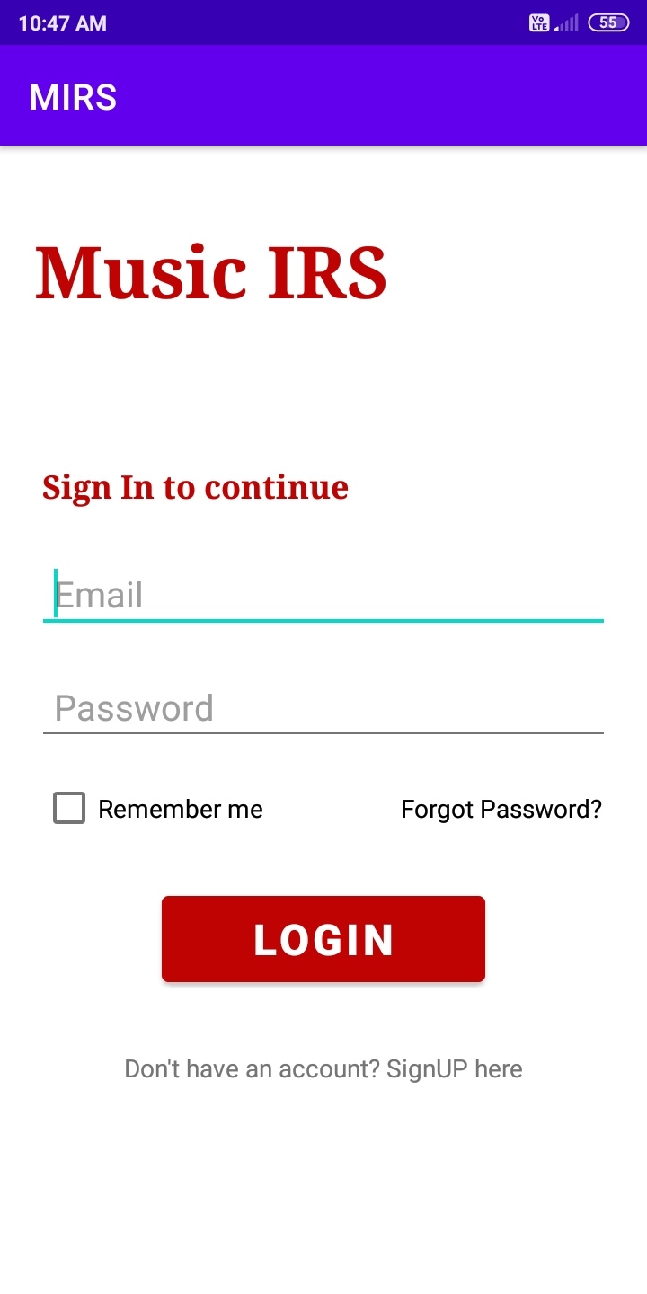
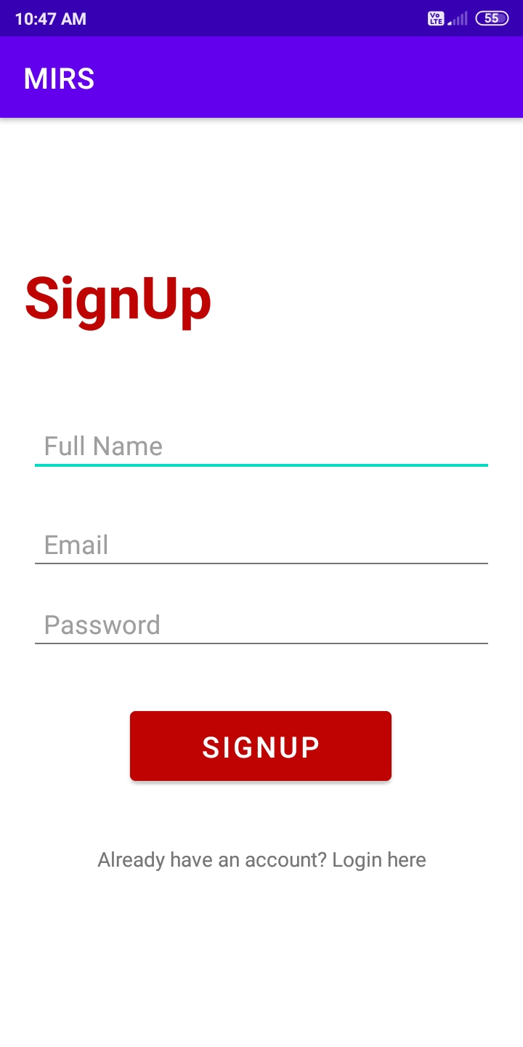
2. Sign in / sign up page.

Slide 24
Progress Till now:
We are using Firebase as our database to store user credentials and application related data.
New user has to sign up and fill the required details and after that user has to verify his Email address. Without verification user cannot login into the application. Once done with the verification step user can excess the application.
Mam, as per our split of project before mid semester, we were about to complete the first two phases which nearly constitute completion of 30% of our Project.

Slide 25
References:
https://aclanthology.org/L16-1312.pdf
https://musicinformationretrieval.com/index.html
Anuj C S(18bcs009)
Arun S M (18bcs013)
Darshan R P(18bcs023)
Jagadeesh C(18bcs033)

Slide 26
THANK YOU

